Slide 1
Chapter 9: Virtual Memory

Slide 2
Chapter 9: Virtual Memory
Background
Demand Paging
Copy-on-Write
Page Replacement
Allocation of Frames
Thrashing
Memory-Mapped Files
Allocating Kernel Memory
Other Considerations
Operating-System Examples

Slide 3
Objectives
To describe the benefits of a virtual memory system
To explain the concepts of demand paging, page-replacement algorithms, and allocation of page frames
To discuss the principle of the working-set model

Slide 4
Background
Code needs to be in memory to execute, but entire program rarely used
Error code, unusual routines, large data structures
Entire program code not needed at same time
Consider ability to execute partially-loaded program
Program no longer constrained by limits of physical memory
Program and programs could be larger than physical memory

Slide 5
Background
Virtual memory – separation of user logical memory from physical memory
Only part of the program needs to be in memory for execution
Logical address space can therefore be much larger than physical address space
Allows address spaces to be shared by several processes
Allows for more efficient process creation
More programs running concurrently
Less I/O needed to load or swap processes
Virtual memory can be implemented via:
Demand paging
Demand segmentation

Slide 6
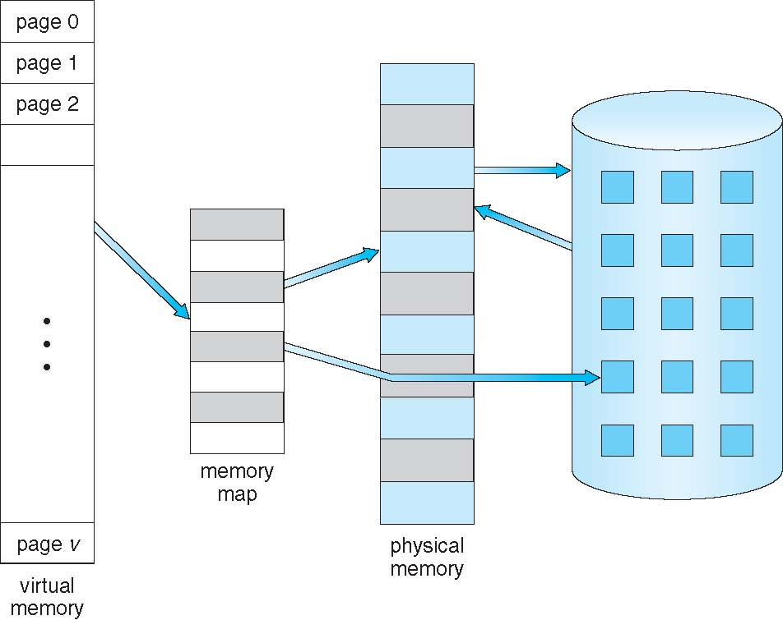
Virtual Memory That is Larger Than Physical Memory

Slide 7
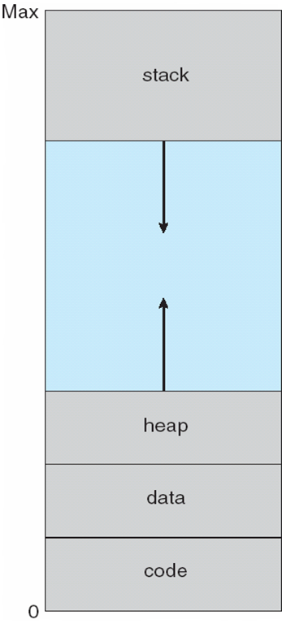
Virtual-address Space

Slide 8
Virtual Address Space
Enables sparse address spaces with holes left for growth, dynamically linked libraries, etc
System libraries shared via mapping into virtual address space
Shared memory by mapping pages read-write into virtual address space
Pages can be shared during fork(), speeding process creation

Slide 9
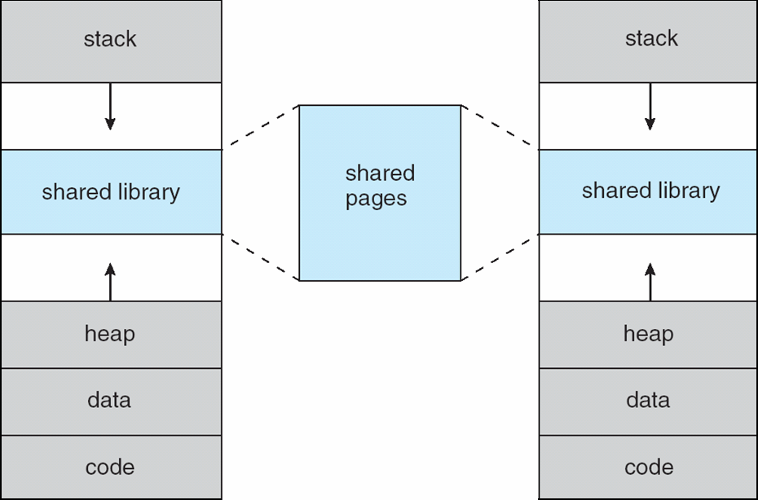
Shared Library Using Virtual Memory

Slide 10
Demand Paging
Could bring entire process into memory at load time
Or bring a page into memory only when it is needed
Less I/O needed, no unnecessary I/O
Less memory needed
Faster response
More users
Page is needed ⇒ reference to it
invalid reference ⇒ abort
not-in-memory ⇒ bring to memory
Lazy swapper – never swaps a page into memory unless page will be needed
Swapper that deals with pages is a pager

Slide 11
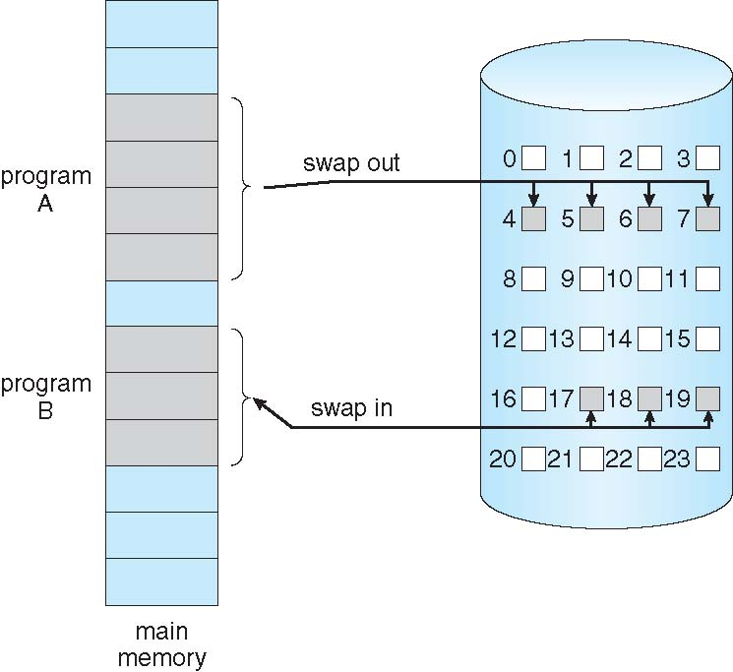
Transfer of a Paged Memory to Contiguous Disk Space

Slide 12
Valid-Invalid Bit
With each page table entry a valid–invalid bit is associated (v ⇒ in-memory – memory resident, i ⇒ not-in-memory)
Initially valid–invalid bit is set to i on all entries
Example of a page table snapshot:
During address translation, if valid–invalid bit in page table entry
is I ⇒ page fault
Frame #
valid-invalid bit
v
v
v
v
i
….
i
i
page table

Slide 13
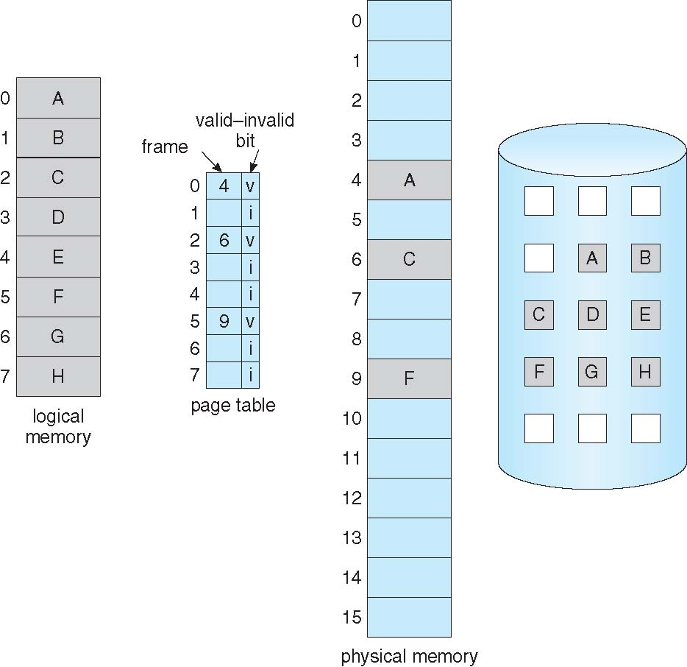
Page Table When Some Pages Are Not in Main Memory

Slide 14
Page Fault
If there is a reference to a page, first reference to that page will trap to operating system:
page fault
Operating system looks at another table to decide:
Invalid reference ⇒ abort
Just not in memory
Get empty frame
Swap page into frame via scheduled disk operation
Reset tables to indicate page now in memory Set validation bit = v
Restart the instruction that caused the page fault

Slide 15
Aspects of Demand Paging
Extreme case – start process with no pages in memory
OS sets instruction pointer to first instruction of process, non-memory-resident -> page fault
And for every other process pages on first access
Pure demand paging
Actually, a given instruction could access multiple pages -> multiple page faults
Pain decreased because of locality of reference
Hardware support needed for demand paging
Page table with valid / invalid bit
Secondary memory (swap device with swap space)
Instruction restart

Slide 16
Instruction Restart
Consider an instruction that could access several different locations
block move
auto increment/decrement location
Restart the whole operation?
What if source and destination overlap?

Slide 17
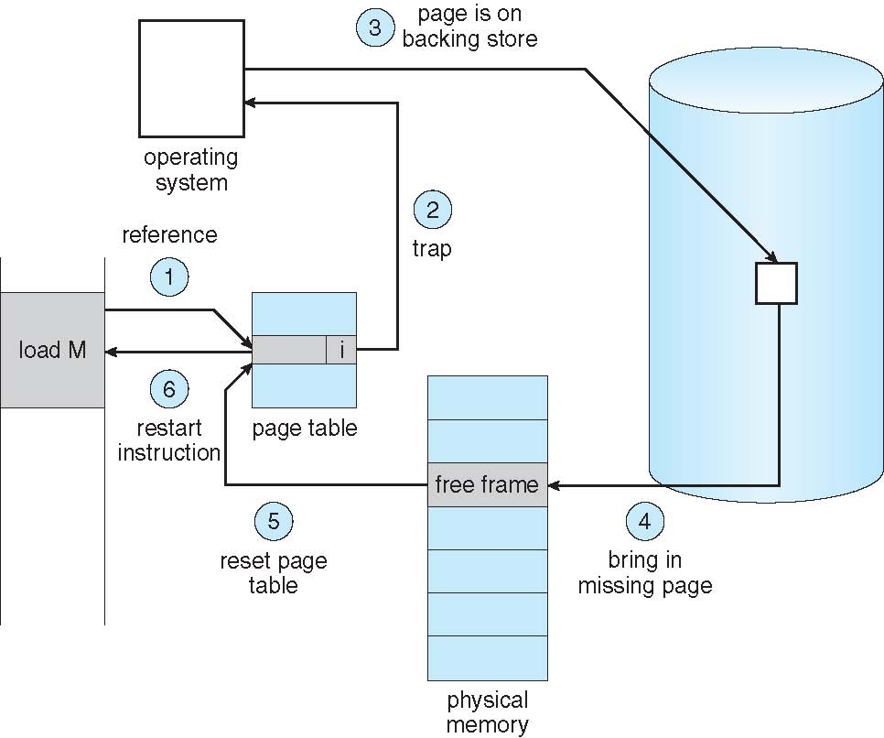
Steps in Handling a Page Fault

Slide 18
Performance of Demand Paging
Stages in Demand Paging
Trap to the operating system
Save the user registers and process state
Determine that the interrupt was a page fault
Check that the page reference was legal and determine the location of the page on the disk
Issue a read from the disk to a free frame:
Wait in a queue for this device until the read request is serviced
Wait for the device seek and/or latency time
Begin the transfer of the page to a free frame
While waiting, allocate the CPU to some other user
Receive an interrupt from the disk I/O subsystem (I/O completed)
Save the registers and process state for the other user
Determine that the interrupt was from the disk
Correct the page table and other tables to show page is now in memory
Wait for the CPU to be allocated to this process again
Restore the user registers, process state, and new page table, and then resume the interrupted instruction

Slide 19
Performance of Demand Paging (Cont.)
Page Fault Rate 0 ≤ p ≤ 1
if p = 0 no page faults
if p = 1, every reference is a fault
Effective Access Time (EAT)
EAT = (1 – p) x memory access
+ p (page fault overhead
+ swap page out
+ swap page in
+ restart overhead
)

Slide 20
Demand Paging Example
Memory access time = 200 nanoseconds
Average page-fault service time = 8 milliseconds
EAT = (1 – p) x 200 + p (8 milliseconds)
= (1 – p x 200 + p x 8,000,000
= 200 + p x 7,999,800
If one access out of 1,000 causes a page fault, then
EAT = 8.2 microseconds.
This is a slowdown by a factor of 40!!
If want performance degradation < 10 percent
220 > 200 + 7,999,800 x p 20 > 7,999,800 x p
p < .0000025
< one page fault in every 400,000 memory accesses

Slide 21
Demand Paging Optimizations
Copy entire process image to swap space at process load time
Then page in and out of swap space
Used in older BSD Unix
Demand page in from program binary on disk, but discard rather than paging out when freeing frame
Used in Solaris and current BSD

Slide 22
Copy-on-Write
Copy-on-Write (COW) allows both parent and child processes to initially share the same pages in memory
If either process modifies a shared page, only then is the page copied
COW allows more efficient process creation as only modified pages are copied
In general, free pages are allocated from a pool of zero-fill-on-demand pages
Why zero-out a page before allocating it?
vfork() variation on fork() system call has parent suspend and child using copy-on-write address space of parent
Designed to have child call exec()
Very efficient

Slide 23
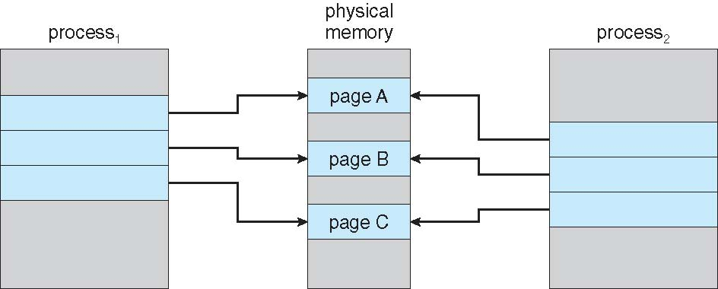
Before Process 1 Modifies Page C

Slide 24
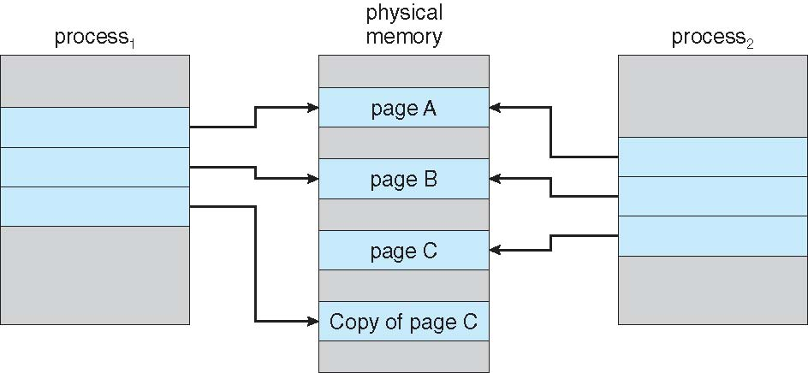
After Process 1 Modifies Page C

Slide 25
What Happens if There is no Free Frame?
Used up by process pages
Also in demand from the kernel, I/O buffers, etc
How much to allocate to each?
Page replacement – find some page in memory, but not really in use, page it out
Algorithm – terminate? swap out? replace the page?
Performance – want an algorithm which will result in minimum number of page faults
Same page may be brought into memory several times

Slide 26
Page Replacement
Prevent over-allocation of memory by modifying page-fault service routine to include page replacement
Use modify (dirty) bit to reduce overhead of page transfers – only modified pages are written to disk
Page replacement completes separation between logical memory and physical memory – large virtual memory can be provided on a smaller physical memory

Slide 27
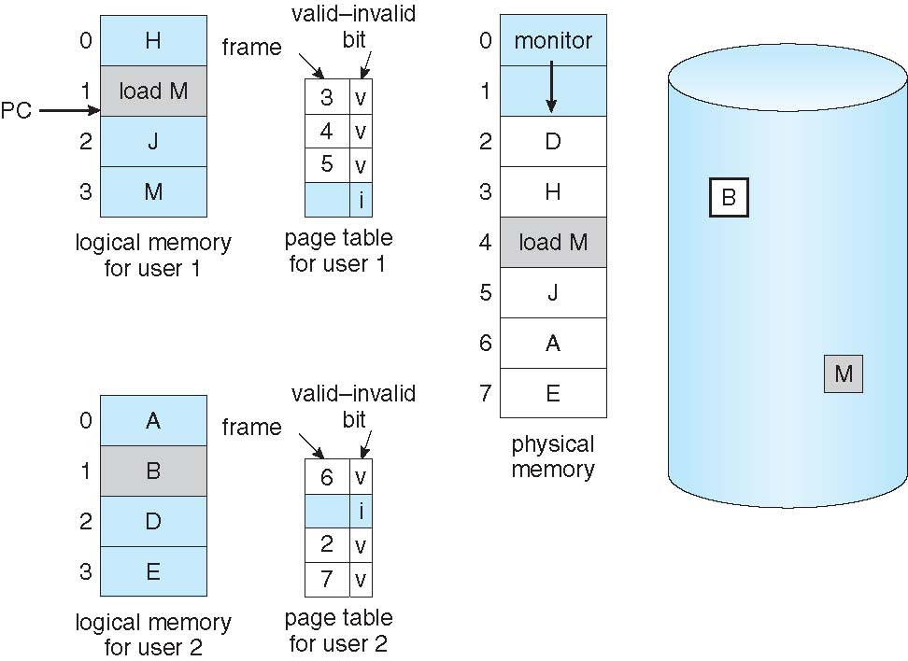
Need For Page Replacement

Slide 28
Basic Page Replacement
Find the location of the desired page on disk
Find a free frame: - If there is a free frame, use it - If there is no free frame, use a page replacement algorithm to select a victim frame - Write victim frame to disk if dirty
Bring the desired page into the (newly) free frame; update the page and frame tables
Continue the process by restarting the instruction that caused the trap
Note now potentially 2 page transfers for page fault – increasing EAT

Slide 29
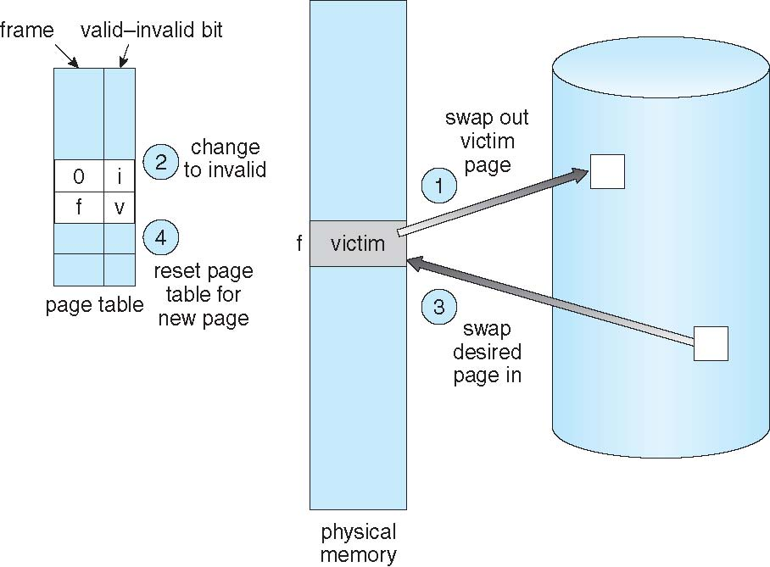
Page Replacement

Slide 30
Page and Frame Replacement Algorithms
Frame-allocation algorithm determines
How many frames to give each process
Which frames to replace
Page-replacement algorithm
Want lowest page-fault rate on both first access and re-access
Evaluate algorithm by running it on a particular string of memory references (reference string) and computing the number of page faults on that string
String is just page numbers, not full addresses
Repeated access to the same page does not cause a page fault
In all our examples, the reference string is
7,0,1,2,0,3,0,4,2,3,0,3,0,3,2,1,2,0,1,7,0,1

Slide 31
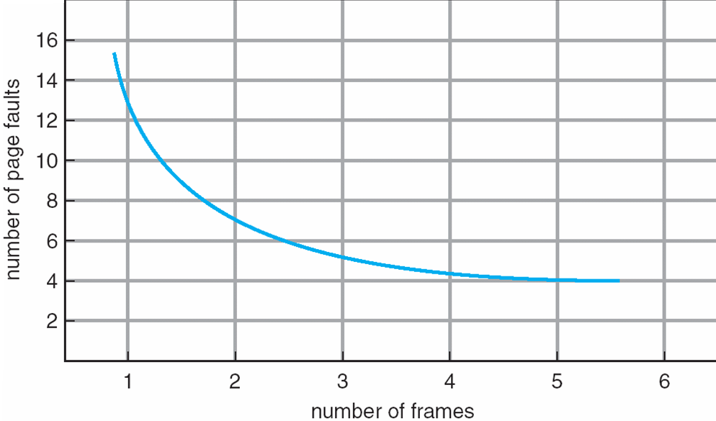
Graph of Page Faults Versus The Number of Frames

Slide 32
First-In-First-Out (FIFO) Algorithm
Reference string: 7,0,1,2,0,3,0,4,2,3,0,3,0,3,2,1,2,0,1,7,0,1
3 frames (3 pages can be in memory at a time per process)
Can vary by reference string: consider 1,2,3,4,1,2,5,1,2,3,4,5
Adding more frames can cause more page faults!
Belady’s Anomaly
How to track ages of pages?
Just use a FIFO queue
1
7
2
4 0 7
2
0
3
15 page faults
2 1 0
3
1
0
3 2 1

Slide 33
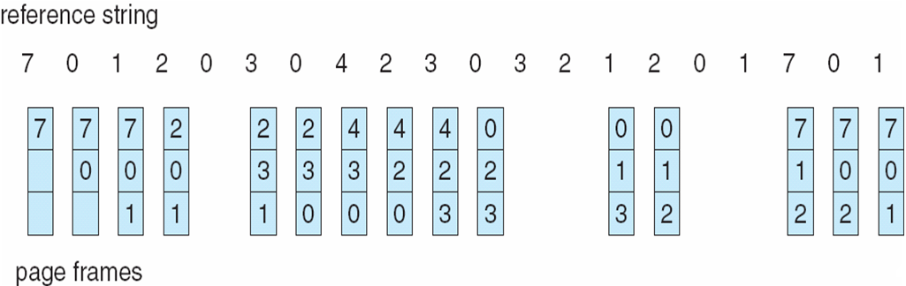
FIFO Page Replacement

Slide 34
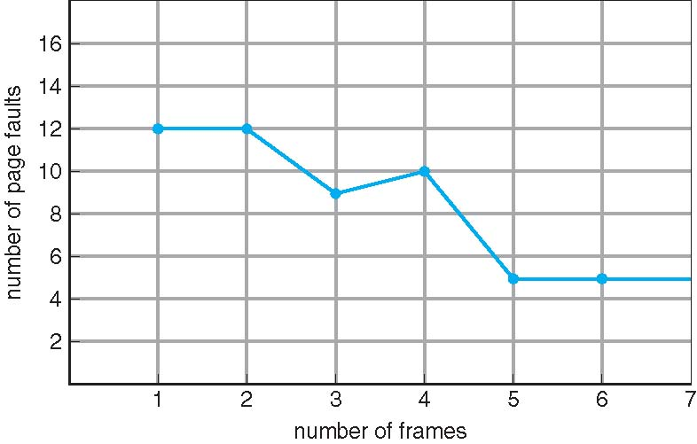
FIFO Illustrating Belady’s Anomaly

Slide 35
Optimal Algorithm
Replace page that will not be used for longest period of time
9 is optimal for the example on the next slide
How do you know this?
Can’t read the future
Used for measuring how well your algorithm performs

Slide 36
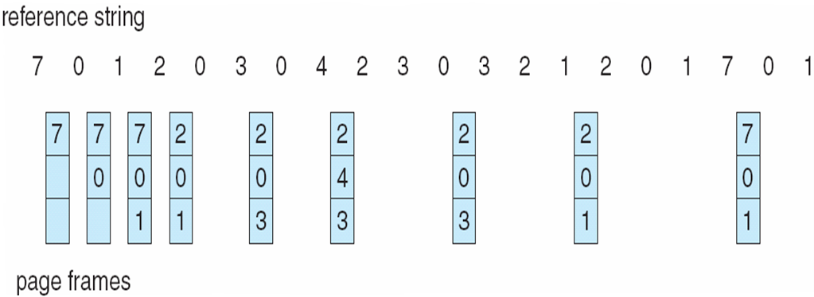
Optimal Page Replacement

Slide 37
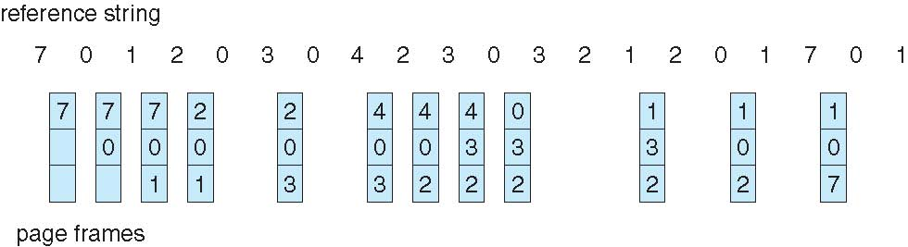
Least Recently Used (LRU) Algorithm
Use past knowledge rather than future
Replace page that has not been used in the most amount of time
Associate time of last use with each page
12 faults – better than FIFO but worse than OPT
Generally good algorithm and frequently used
But how to implement?

Slide 38
LRU Algorithm (Cont.)
Counter implementation
Every page entry has a counter; every time page is referenced through this entry, copy the clock into the counter
When a page needs to be changed, look at the counters to find smallest value
Search through table needed
Stack implementation
Keep a stack of page numbers in a double link form:
Page referenced:
move it to the top
requires 6 pointers to be changed
But each update more expensive
No search for replacement
LRU and OPT are cases of stack algorithms that don’t have Belady’s Anomaly

Slide 39
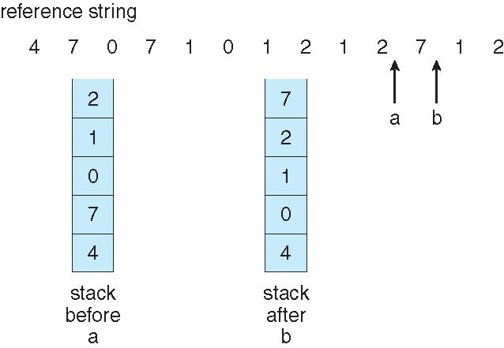
Use Of A Stack to Record The Most Recent Page References

Slide 40
LRU Approximation Algorithms
LRU needs special hardware and still slow
Reference bit
With each page associate a bit, initially = 0
When page is referenced bit set to 1
Replace any with reference bit = 0 (if one exists)
We do not know the order, however
Additional Reference Bits Algorithm:
8 bit byte used, at regular intervals OS shifts the Reference bit for each page to right by 1 bit. 00000000- LRU 11111111 . i.e. a page used at least once in each period.
Second-chance algorithm
Generally FIFO, plus hardware-provided reference bit
Clock replacement
If page to be replaced has
Reference bit = 0 -> replace it
reference bit = 1 then:
set reference bit 0, leave page in memory
replace next page, subject to same rules

Slide 41
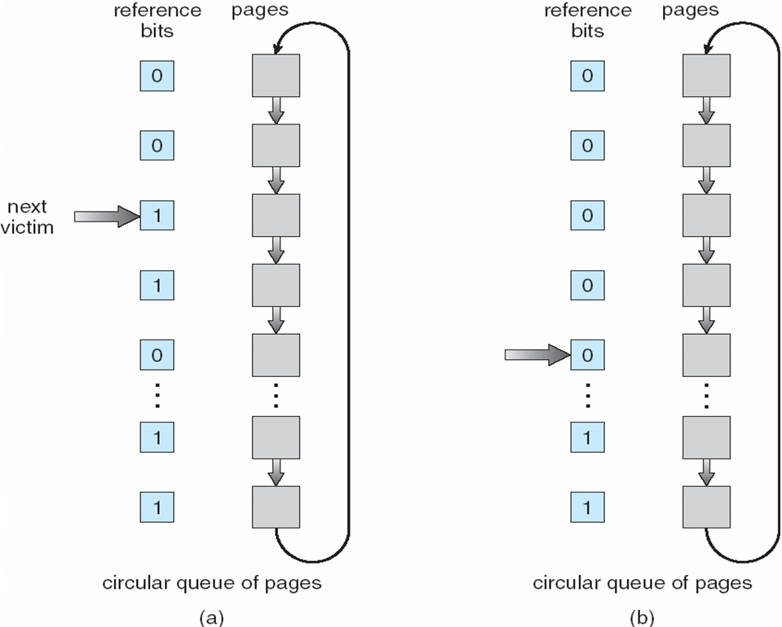
Second-Chance (clock) Page-Replacement Algorithm

Slide 42
Enhanced Second Chance Algorithm:
Considering two bits Reference Bit and Modify Bit. So 4 cases:
(0, 0)– neither recently used nor modified- best page to replace
(0,1)- not recently used but modified – not quite as good, because the page will need to be written out before replacement.
(1,0)- recently used but clean- probably will be used again soon.
(1,1)- recently used and modified- probably will be used again soon and the page will be need to be written out to disk before it can be replaced.

Slide 43
Counting Algorithms
Keep a counter of the number of references that have been made to each page
Not common
Expensive
Not optimal
LFU Algorithm: replaces page with smallest count. In case the page is used very heavily in first initial phase and then never used. It still remains in the memory since it will have a huge count. Better to shift the counts right by 1 bit at regular intervals, forming an exponentially decaying average usage count.
MFU Algorithm: based on the argument that the page with the smallest count was probably just brought in and has yet to be used

Slide 44
Page-Buffering Algorithms
Keep a pool of free frames, always
Then frame available when needed, not found at fault time
Read page into free frame and select victim to evict and add to free pool
When convenient, evict victim
Possibly, keep list of modified pages
When backing store otherwise idle, write pages there and set to non-dirty
Possibly, keep free frame contents intact and note what is in them
If referenced again before reused, no need to load contents again from disk
Generally useful to reduce penalty if wrong victim frame selected

Slide 45
Applications and Page Replacement
All of these algorithms have OS guessing about future page access
Some applications have better knowledge – i.e. databases
Memory intensive applications can cause double buffering
OS keeps copy of page in memory as I/O buffer
Application keeps page in memory for its own work
Operating system can given direct access to the disk, getting out of the way of the applications
Raw disk mode
Bypasses buffering, locking, etc

Slide 46
Allocation of Frames
Each process needs minimum number of frames
Example: IBM 370 – 6 pages to handle SS MOVE instruction:
instruction is 6 bytes, might span 2 pages
2 pages to handle from
2 pages to handle to
Maximum of course is total frames in the system
Indirection to be limited to 16
Minimum number of frames is decided by architecture and maximum number of frames is defined by the amount of available physical memory.
Two major allocation schemes
fixed allocation
priority allocation
Many variations

Slide 47
Fixed Allocation
Equal allocation – For example, if there are 100 frames (after allocating frames for the OS) and 5 processes, give each process 20 frames
Keep some as free frame buffer pool
Proportional allocation – Allocate according to the size of process
Dynamic as degree of multiprogramming, process sizes change

Slide 48
Priority Allocation
Use a proportional allocation scheme using priorities rather than size
If process P_{i} generates a page fault,
select for replacement one of its frames
select for replacement a frame from a process with lower priority number

Slide 49
Global vs. Local Allocation
Global replacement – process selects a replacement frame from the set of all frames; one process can take a frame from another
But then process execution time can vary greatly
But greater throughput so more common
Local replacement – each process selects from only its own set of allocated frames
More consistent per-process performance
But possibly underutilized memory

Slide 50
Non-Uniform Memory Access
So far all memory accessed equally
Many systems are NUMA – speed of access to memory varies
Consider system boards containing CPUs and memory, interconnected over a system bus
Optimal performance comes from allocating memory “close to” the CPU on which the thread is scheduled
And modifying the scheduler to schedule the thread on the same system board when possible
Solved by Solaris by creating lgroups
Structure to track CPU / Memory low latency groups
Used my schedule and pager
When possible schedule all threads of a process and allocate all memory for that process within the lgroup

Slide 51
Thrashing
Number of frames allocated to a low priority process is equal to or more than the minimum number required by the computer architecture.
If a low priority process does not have “enough” pages, the page-fault rate is very high
Page fault to get page
Replace existing frame
But quickly need replaced frame back
This leads to:
Low CPU utilization
Operating system thinking that it needs to increase the degree of multiprogramming
Another process added to the system
Thrashing ≡ a process is busy swapping pages in and out

Slide 52
Thrashing
Consider that OS monitors CPU Utilization.
If CPU Utilization is low then to increase degree of multiprogramming more programs are added.
A global replacement algorithm is used. Where in a process in need of frames will replace the other processes frames.
Which in turn will also replace other processes frames.
So ready queue empties and the processes wait for paging device since each of their process pages needs to be paged by the pager.
The CPU scheduler sees the low CPU utilization and increases the degree of multiprogramming.

Slide 53
Thrashing
Thus the new process causes more page faults by taking frames from running processes.
This keeps on continuing since low the CPU utilization more programs would be put to run by scheduler.
Thrashing occurs. Page fault increases tremendously.
Effective memory access time increases since processes are spending their time paging.
We can limit the effects of thrashing by using a local replacement algorithm or priority replacement algorithm.
Local can limit stealing frames from another process and cause the latter to thrash as well. But the problem is not entirely solved.
If processes are thrashing they will be in the queue for the paging device most of the time. The average service time for a page fault will increase. Thus the effective access time will increase even for a process that is not thrashing.

Slide 54
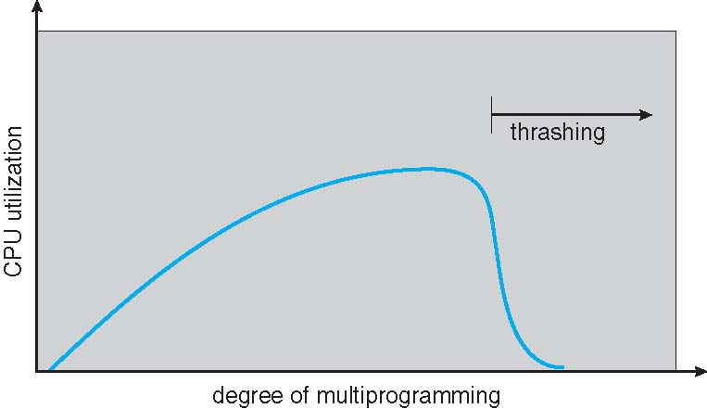
Thrashing (Cont.)

Slide 55
Locality Set
To prevent thrashing provide a process with as many frames as it needs.
How do we know how many frames it needs???
One technique- Working Set Strategy.
This approach defines the locality model of process execution.
The locality model states: as a process executes, it moves from locality to locality.
Locality is a set of pages that are actively used together.
Example: when a function is called, it defines a new locality. In this locality memory references are made to the instructions of the function call, its local variables and a subset of the global variables.
When we exit the function the process leaves this locality, since the local variables and instructions of the function are no longer in active use.
Suppose we allocate enough frames to a process to accommodate its current locality.
It will fault fro the pages in its locality until all these pages are in memory then it will not fault again until it changes localities.
If we do not allocate enough frames to accommodate the size of the current locality the process will thrash.

Slide 56
Demand Paging and Thrashing
Why does demand paging work? Locality model
Process migrates from one locality to another
Localities may overlap
Why does thrashing occur? Σ size of locality > total memory size
Limit effects by using local or priority page replacement

Slide 57
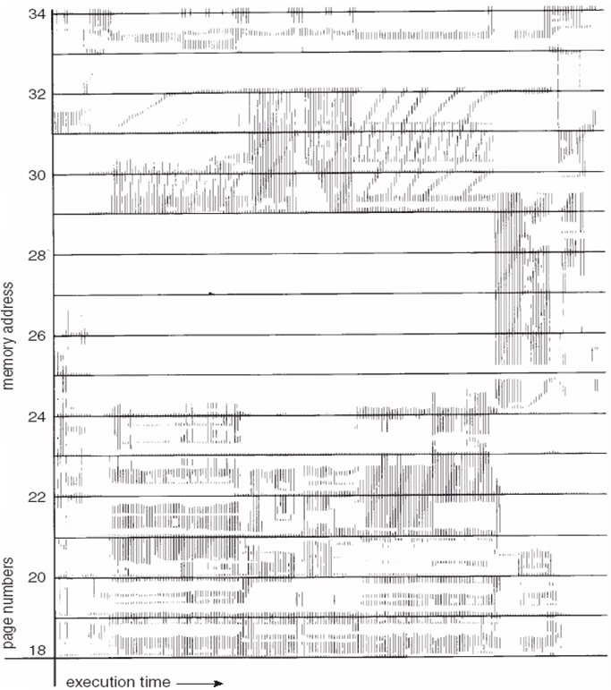
Locality In A Memory-Reference Pattern

Slide 58
Working-Set Model
Δ ≡ working-set window ≡ a fixed number of page references Example: 10,000 instructions
WSS_{i} (working set of Process P_{i}) = total number of pages referenced in the most recent Δ (varies in time)
if Δ too small will not encompass entire locality
if Δ too large will encompass several localities
if Δ = ∞ ⇒ will encompass entire program
D = Σ WSS_{i} ≡ total demand frames
Approximation of locality
if D > m ⇒ Thrashing
Policy if D > m, then suspend or swap out one of the processes

Slide 59
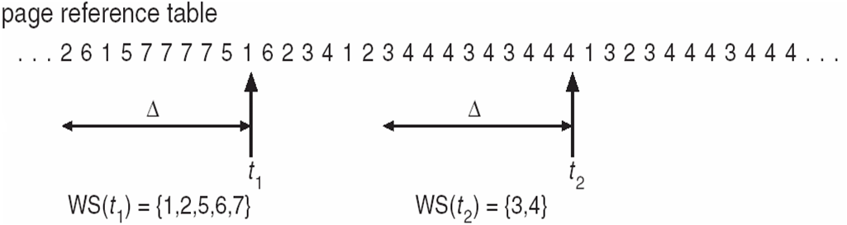
Working-set model

Slide 60
Working of Working set model
Once working set window is selected, the OS monitors the working set of each process and allocates to that working set enough frames to provide it with its working set size.
If there are enough extra frames, another process can be initiated.
If the sum of the working set increases, exceeding the total number of available frames, the OS selects a process to suspend.
The suspended process’s pages are swapped and its frames are reallocated to other processes.
Difficulty here is to keep track of Working set.
Since it is a moving window, at each memory reference a new reference appears at one end and the oldest reference drops off the other end.

Slide 61
Keeping Track of the Working Set
Approximate with interval timer + a reference bit
Example: Δ = 10,000
Timer interrupts after every 5000 time units
Keep in memory 2 bits for each page
Whenever a timer interrupts copy and sets the values of all reference bits to 0
If one of the bits in memory = 1 ⇒ page in working set
Why is this not completely accurate?
Improvement = 10 bits and interrupt every 1000 time units

Slide 62
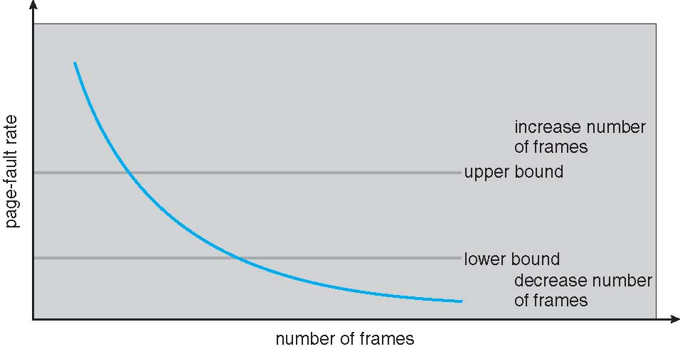
Page-Fault Frequency
More direct approach than WSS
Establish “acceptable” page-fault frequency rate and use local replacement policy
If actual rate too low, process loses frame
If actual rate too high, process gains frame

Slide 63
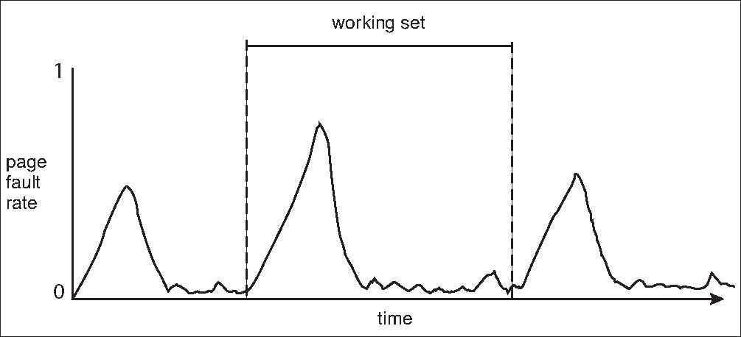
Working Sets and Page Fault Rates

Slide 64
Memory-Mapped Files
Memory-mapped file I/O allows file I/O to be treated as routine memory access by mapping a disk block to a page in memory
A file is initially read using demand paging
A page-sized portion of the file is read from the file system into a physical page
Subsequent reads/writes to/from the file are treated as ordinary memory accesses
Simplifies and speeds file access by driving file I/O through memory rather than read() and write() system calls
Also allows several processes to map the same file allowing the pages in memory to be shared
But when does written data make it to disk?
Periodically and / or at file close() time
For example, when the pager scans for dirty pages

Slide 65
Memory-Mapped File Technique for all I/O
Some OSes uses memory mapped files for standard I/O
Process can explicitly request memory mapping a file via mmap() system call
Now file mapped into process address space
For standard I/O (open(), read(), write(), close()), map anyway
But map file into kernel address space
Process still does read() and write()
Copies data to and from kernel space and user space
Uses efficient memory management subsystem
Avoids needing separate subsystem
COW can be used for read/write non-shared pages
Memory mapped files can be used for shared memory (although again via separate system calls)

Slide 66
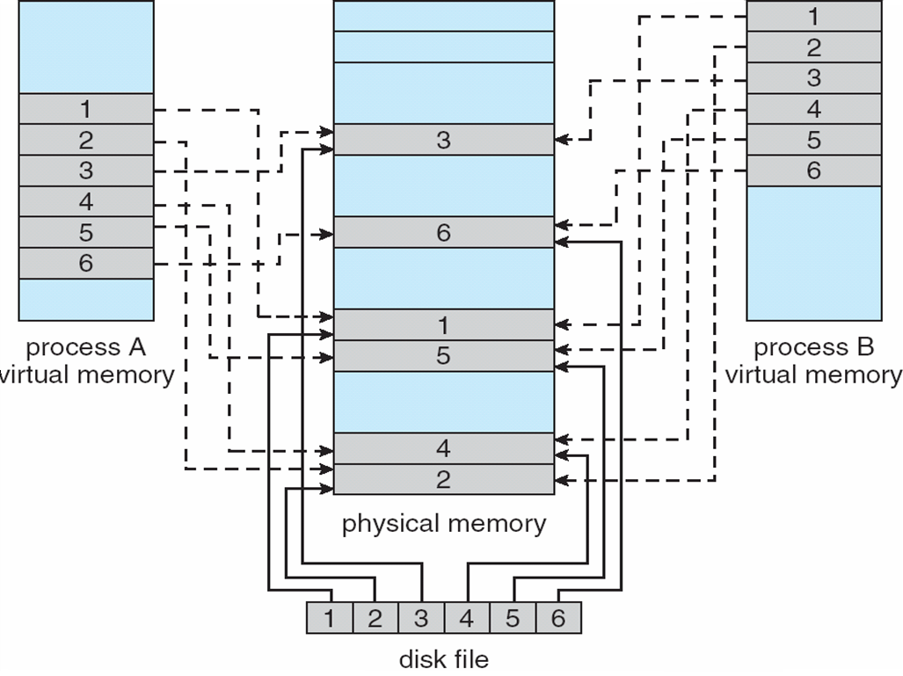
Memory Mapped Files

Slide 67
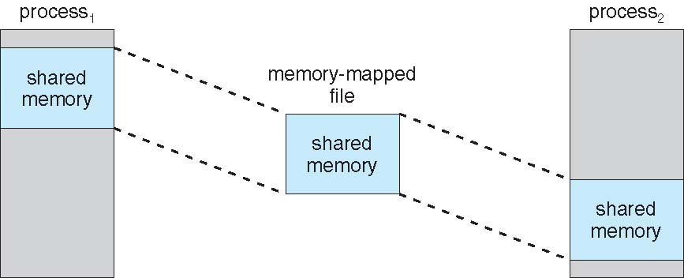
Memory-Mapped Shared Memory in Windows

Slide 68
Allocating Kernel Memory
Treated differently from user memory
Often allocated from a free-memory pool
Kernel requests memory for structures of varying sizes some of them are less than a page in size.
As a result the kernel must use memory conservatively and attempt to minimize waste due to fragmentation.
Some kernel memory needs to be contiguous since hardware devices interact directly with physical memory.
I.e. for device I/O

Slide 69
Buddy System
Allocates memory from fixed-size segment consisting of physically-contiguous pages
Memory allocated using power-of-2 allocator
Satisfies requests in units sized as power of 2
Request rounded up to next highest power of 2
When smaller allocation needed than is available, current chunk split into two buddies of next-lower power of 2
Continue until appropriate sized chunk available
For example, assume 256KB chunk available, kernel requests 21KB
Split into A_{L} _{and} A_{r} of 128KB each
One further divided into B_{L} and B_{R} of 64KB
One further into C_{L} and C_{R} of 32KB each – one used to satisfy request
Advantage – quickly coalesce unused chunks into larger chunk
Disadvantage - fragmentation

Slide 70
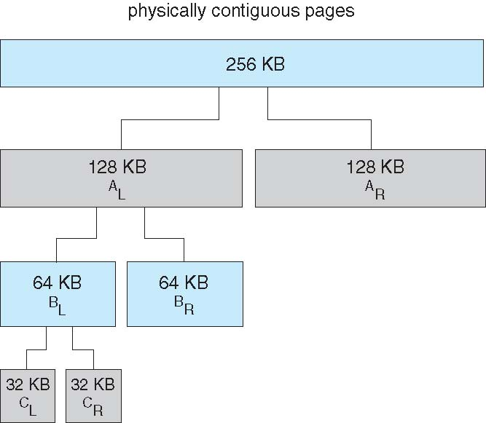
Buddy System Allocator

Slide 71
Slab Allocator
Alternate strategy
Slab is one or more physically contiguous pages
Cache consists of one or more slabs
Single cache for each unique kernel data structure
Each cache filled with objects – instantiations of the data structure
When cache created, filled with objects marked as free
When structures stored, objects marked as used
If slab is full of used objects, next object allocated from empty slab
If no empty slabs, new slab allocated
Benefits include no fragmentation, fast memory request satisfaction

Slide 72
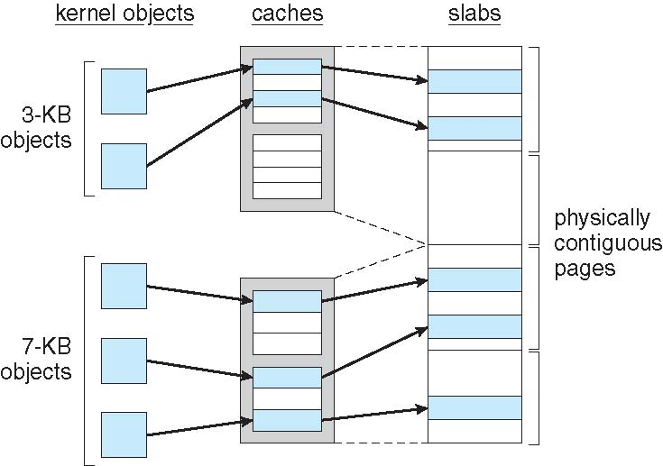
Slab Allocation

Slide 73
Other Considerations -- Prepaging
Prepaging
To reduce the large number of page faults that occurs at process startup
Prepage all or some of the pages a process will need, before they are referenced
But if prepaged pages are unused, I/O and memory was wasted
Assume s pages are prepaged and α of the pages is used
Is cost of s * α save pages faults > or < than the cost of prepaging s * (1- α) unnecessary pages?
α near zero ⇒ prepaging loses

Slide 74
Other Issues – Page Size
Sometimes OS designers have a choice
Especially if running on custom-built CPU
Page size selection must take into consideration:
Fragmentation- Small better
Page table size – Large better
Resolution- Small better
I/O overhead – Large better
Number of page faults – large better
Locality – small better
TLB size and effectiveness – large better
Always power of 2, usually in the range 2¹² (4,096 bytes) to 2²² (4,194,304 bytes)
On average, growing over time

Slide 75
Other Issues – TLB Reach
To improve through TLB you require more access through TLB but more expensive.
TLB Reach - The amount of memory accessible from the TLB
TLB Reach = (TLB Size/Enteries) X (Page Size)
Ideally, the working set of each process is stored in the TLB
Otherwise there is a high degree of page faults
Increase the Page Size
This may lead to an increase in fragmentation as not all applications require a large page size
Provide Multiple Page Sizes
This allows applications that require larger page sizes the opportunity to use them without an increase in fragmentation

Slide 76
Other Issues – Program Structure, Inverted Page Table.
Program structure
Int[128,128] data;
Each row is stored in one page
Program 1
for (j = 0; j <128; j++) for (i = 0; i < 128; i++) data[i,j] = 0;
128 x 128 = 16,384 page faults
Program 2
for (i = 0; i < 128; i++) for (j = 0; j < 128; j++) data[i,j] = 0;
128 page faults

Slide 77
Other Issues – I/O interlock
I/O Interlock – Pages must sometimes be locked into memory
Consider I/O - Pages that are used for copying a file from a device must be locked from being selected for eviction by a page replacement algorithm

Slide 78
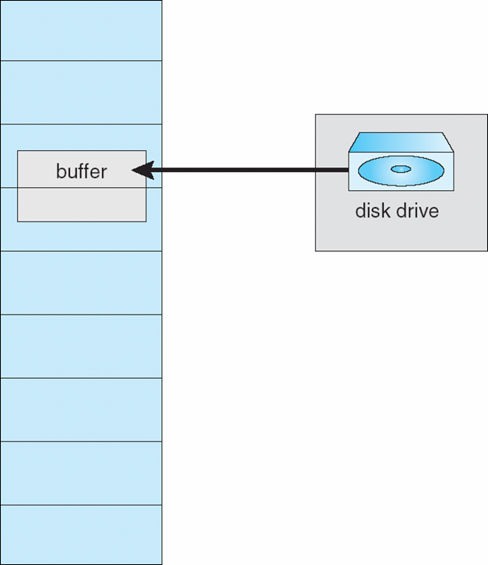
Reason Why Frames Used For I/O Must Be In Memory

Slide 79
Operating System Examples
Windows XP
Solaris

Slide 80
Windows XP
Uses demand paging with clustering. Clustering brings in pages surrounding the faulting page
Processes are assigned working set minimum and working set maximum
Working set minimum is the minimum number of pages the process is guaranteed to have in memory
A process may be assigned as many pages up to its working set maximum
When the amount of free memory in the system falls below a threshold, automatic working set trimming is performed to restore the amount of free memory
Working set trimming removes pages from processes that have pages in excess of their working set minimum

Slide 81
Solaris
Maintains a list of free pages to assign faulting processes
Lotsfree – threshold parameter (amount of free memory) to begin paging
Desfree – threshold parameter to increasing paging
Minfree – threshold parameter to being swapping
Paging is performed by pageout process
Pageout scans pages using modified clock algorithm
Scanrate is the rate at which pages are scanned. This ranges from slowscan to fastscan
Pageout is called more frequently depending upon the amount of free memory available
Priority paging gives priority to process code pages

Slide 82
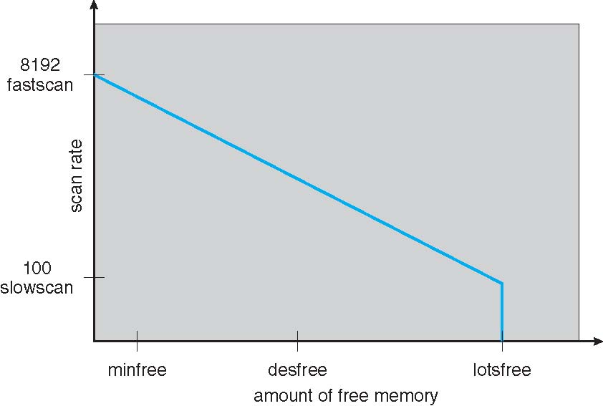
Solaris 2 Page Scanner

Slide 83
End of Chapter 8

